Slide 1
Wildlife Corridor Data Preparation and Analysis Models:
A Case Study Using The Wolverine
SSCI 586 Fall 2018
Chase VanSchoonhoven
SSCI 583

Slide 2
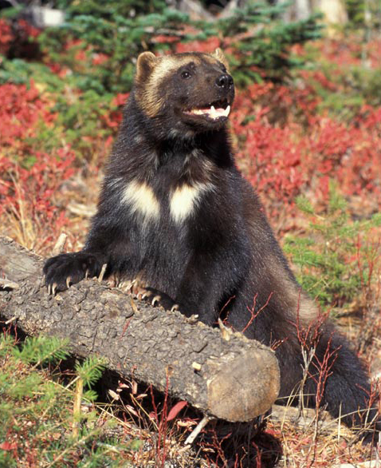
Overview
Introduction
Spatial Question
Study Area
Data Sources
Methodology
Models
Results
Maps
Issues/What Next?
SSCI 583
SECTION TITLE | 2

Slide 3
Introduction
Why I Chose The Wolverine & Corridor Analysis
History with outdoors and conservation
Recent Sightings
Conservation Efforts
Replicability
Spatial Question For The Case Study
What are the best possible paths for the Wolverine to move from its current range in the Northern Cascades and Rockies to its prior(new) range in the Sierra Nevada Mountains?
SSCI 583 | 1
Notes:
Eagles Scout
Pack was the wolverines

Slide 4
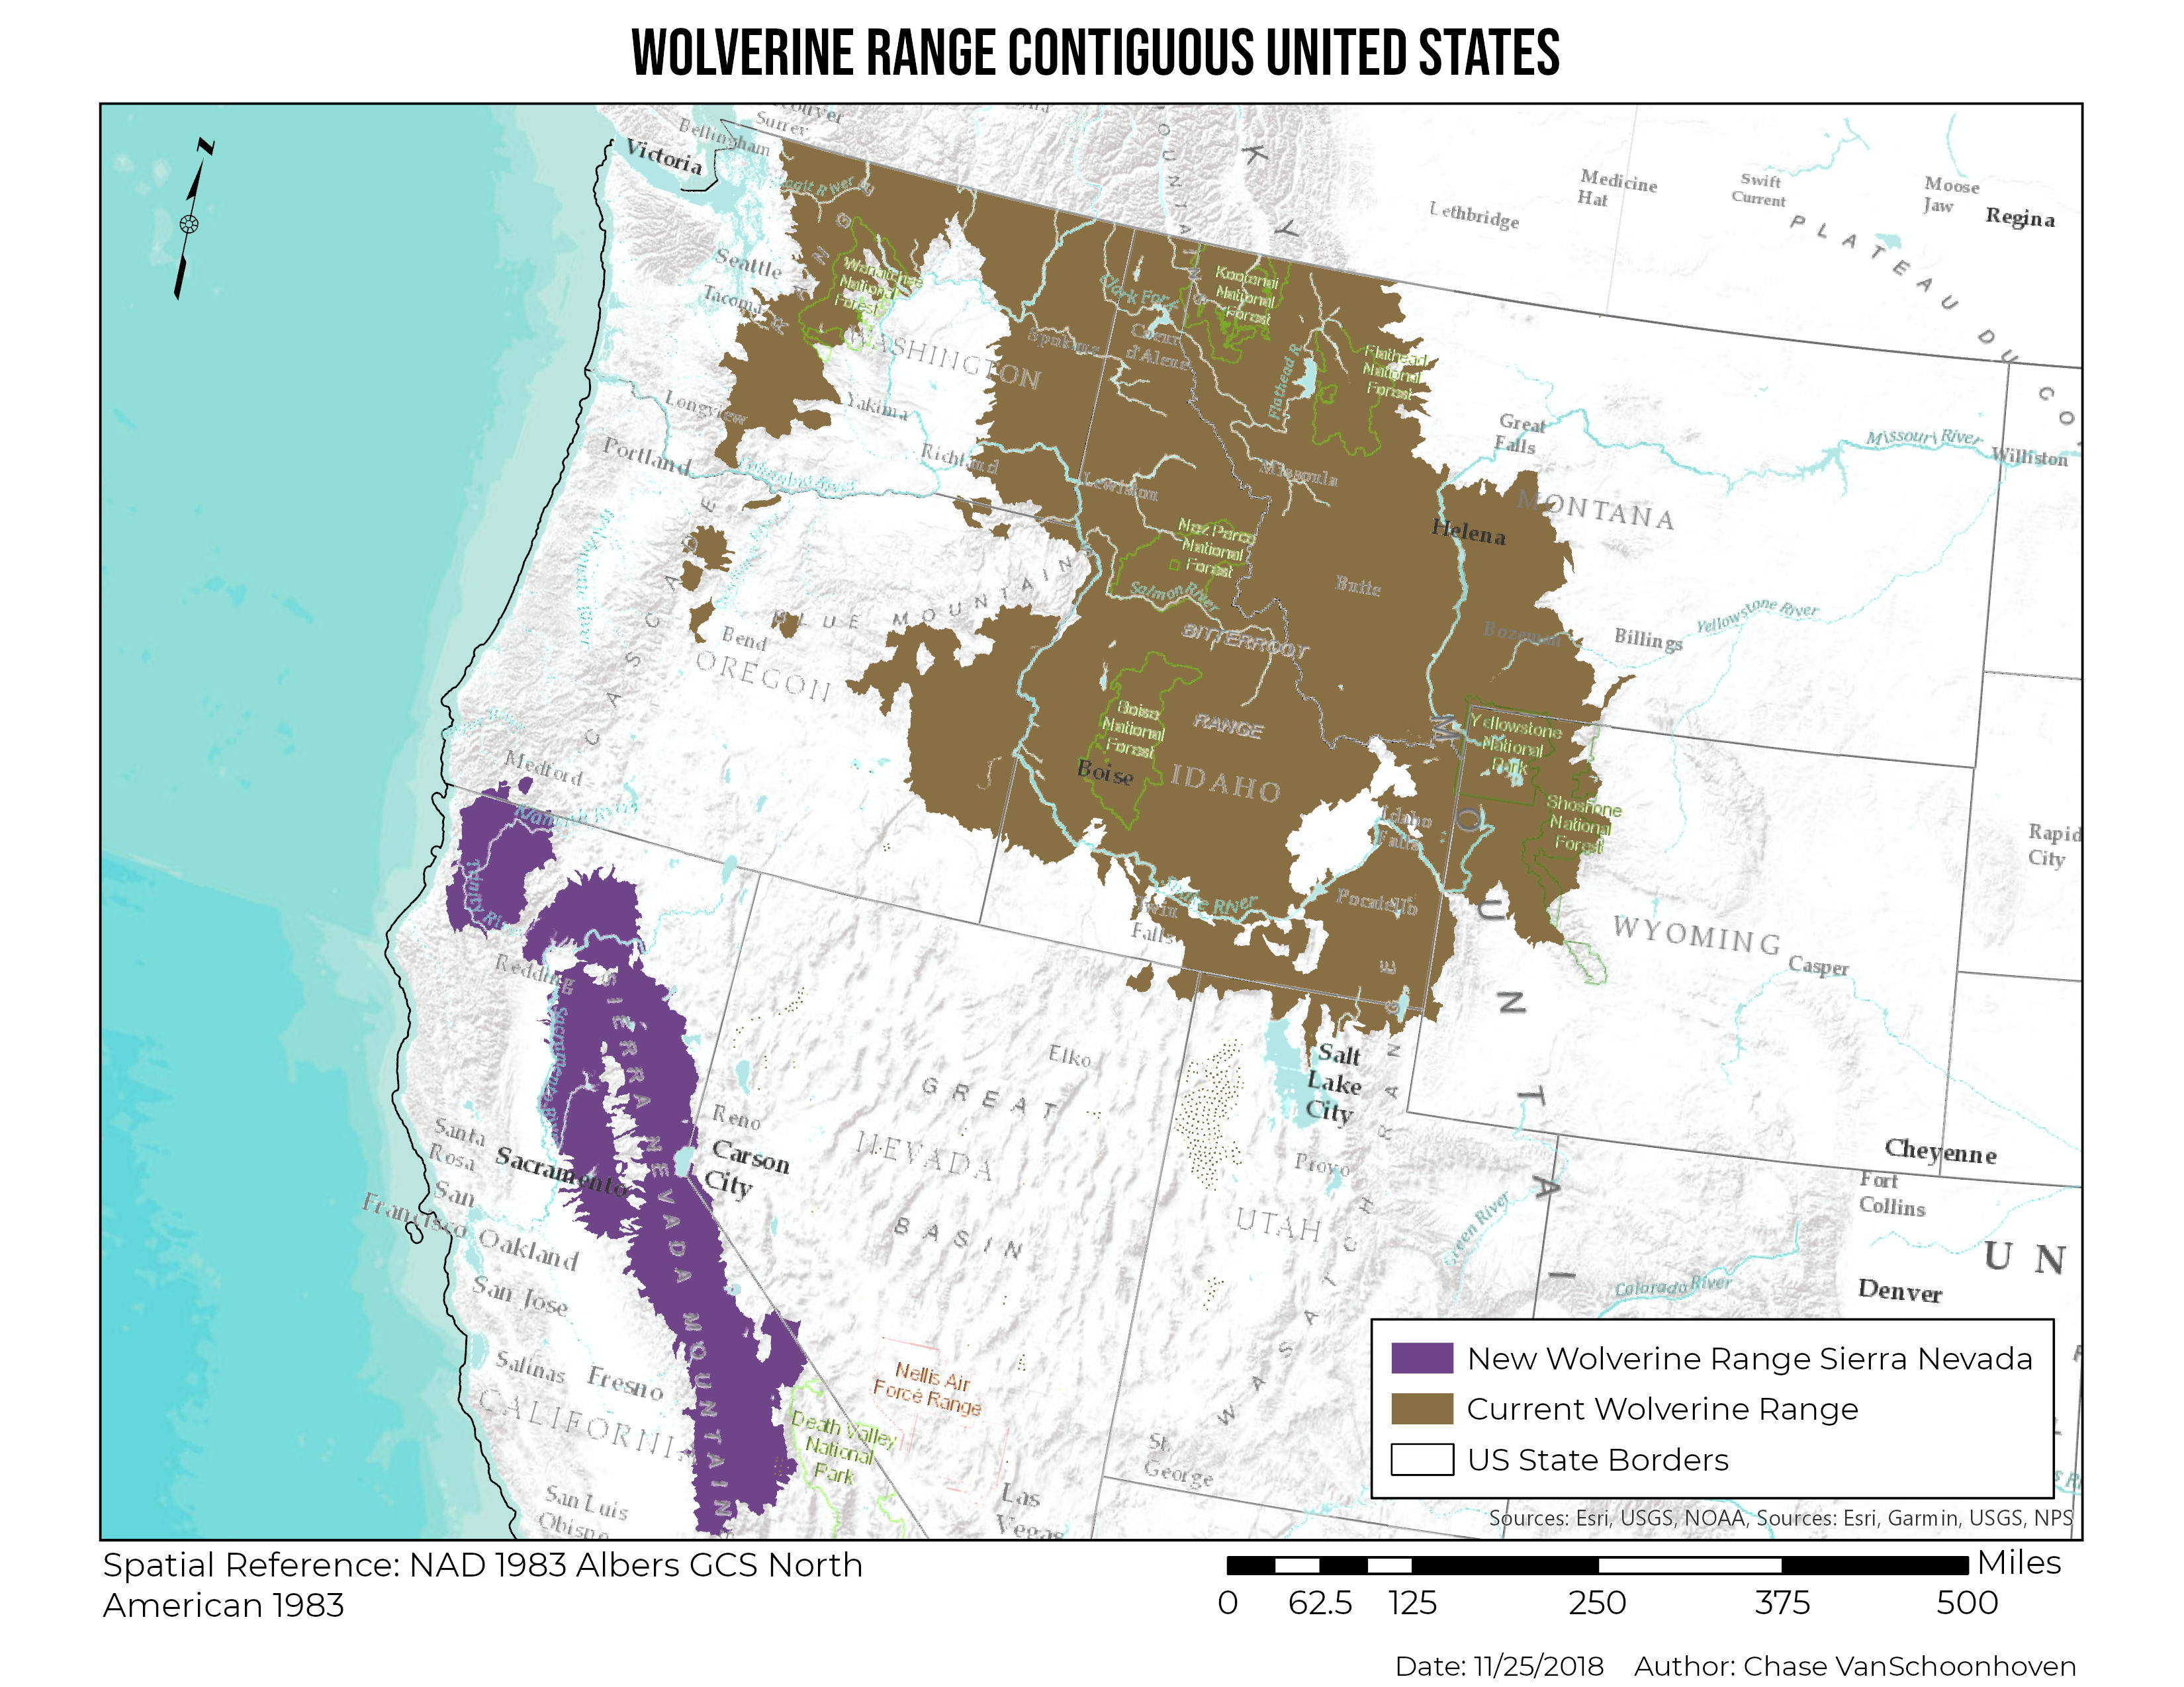
Study Area
SSCI 583 | 2

Slide 5
Data
Data Acquired
Name | Source | Format | Date of compilation | Attributes
DEM | USGS​ ​ | Raster Image | 2010 | 30 meter resolution DEM data.
USGS GAP Land Cover Data | USGS | Raster Image | 2010 | 30 meter resolution land cover data.
Human Impact Avoidance | USGS | Raster Image | 2010 | 30 meter resolution avoidance data.
Species Habitat Model Report
SSCI 583 | 3
SECTION TITLE | 2

Slide 6
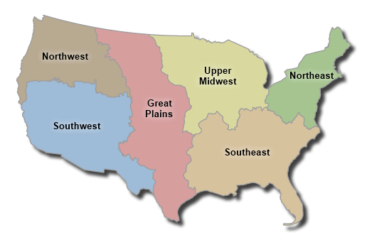
Data
Gap Analysis Program (GAP) six regions
SSCI 583 | 3
SECTION TITLE | 2

Slide 7
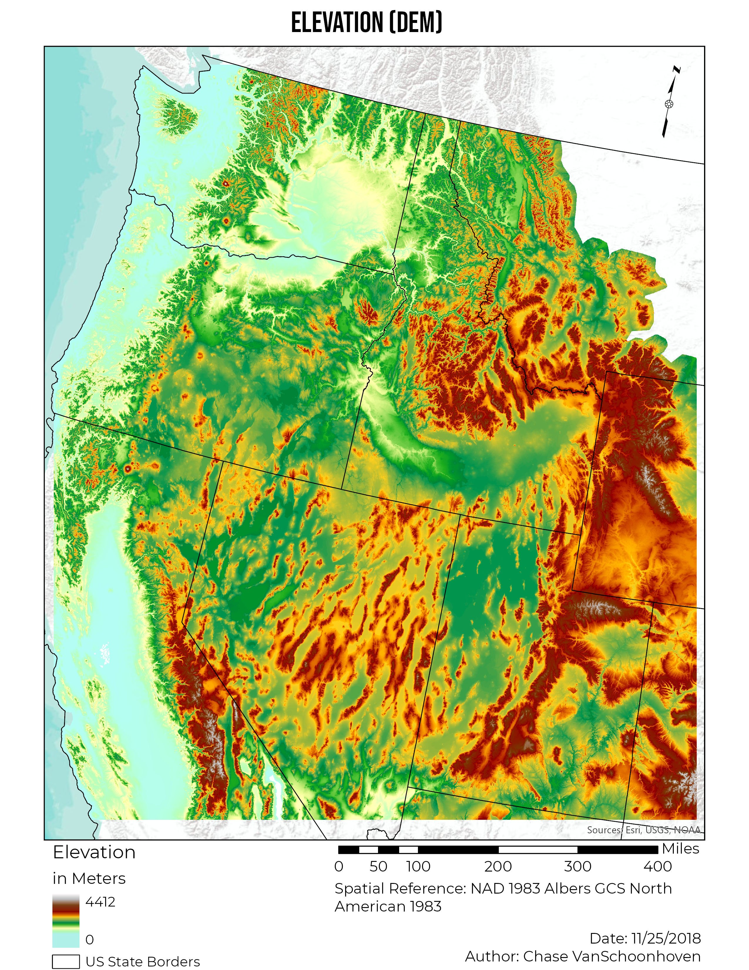
Sources – USGS Elevation DEM
Elevation
Some species respond to environments directly related to altitudinal variation. Elevation was implemented in the spatial model by limiting the model to the minimum and maximum values explicitly stated in the Wolverine’s Species Model Report.
DEMs are measured in meters above mean sea level.
Wolverine elevation minimum is 1820m and maximum is 4420m
SSCI 583 | 4

Slide 8
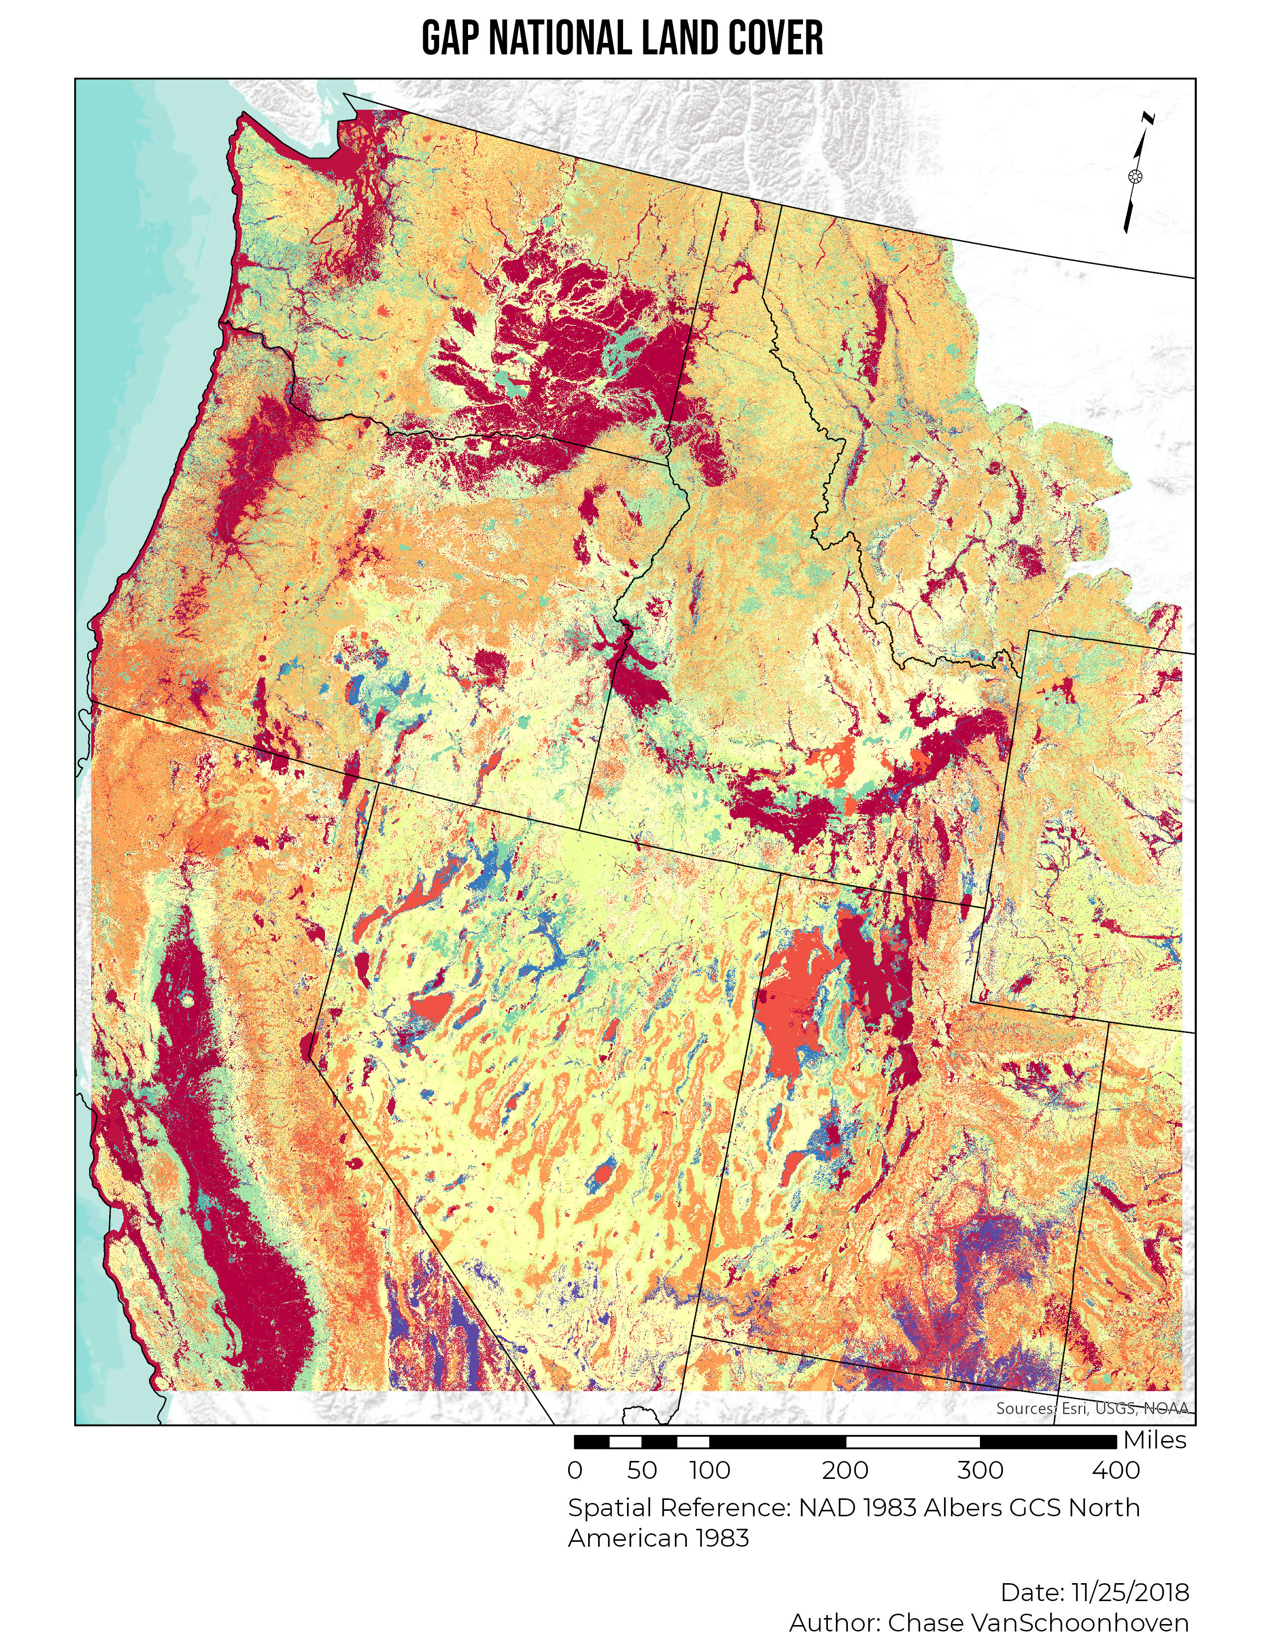
Sources – USGS GAP Land Cover
The ecological systems mapped in the GAP National Land Cover Data were used as ‘map units’ to describe habitat types preferred by species.
680 ecological systems, and 28 land use, introduced vegetation or disturbed classes
240 different land cover and ecological systems in data set
67 Critical Land Cover Types for the Wolverine
SSCI 583 | 5

Slide 9
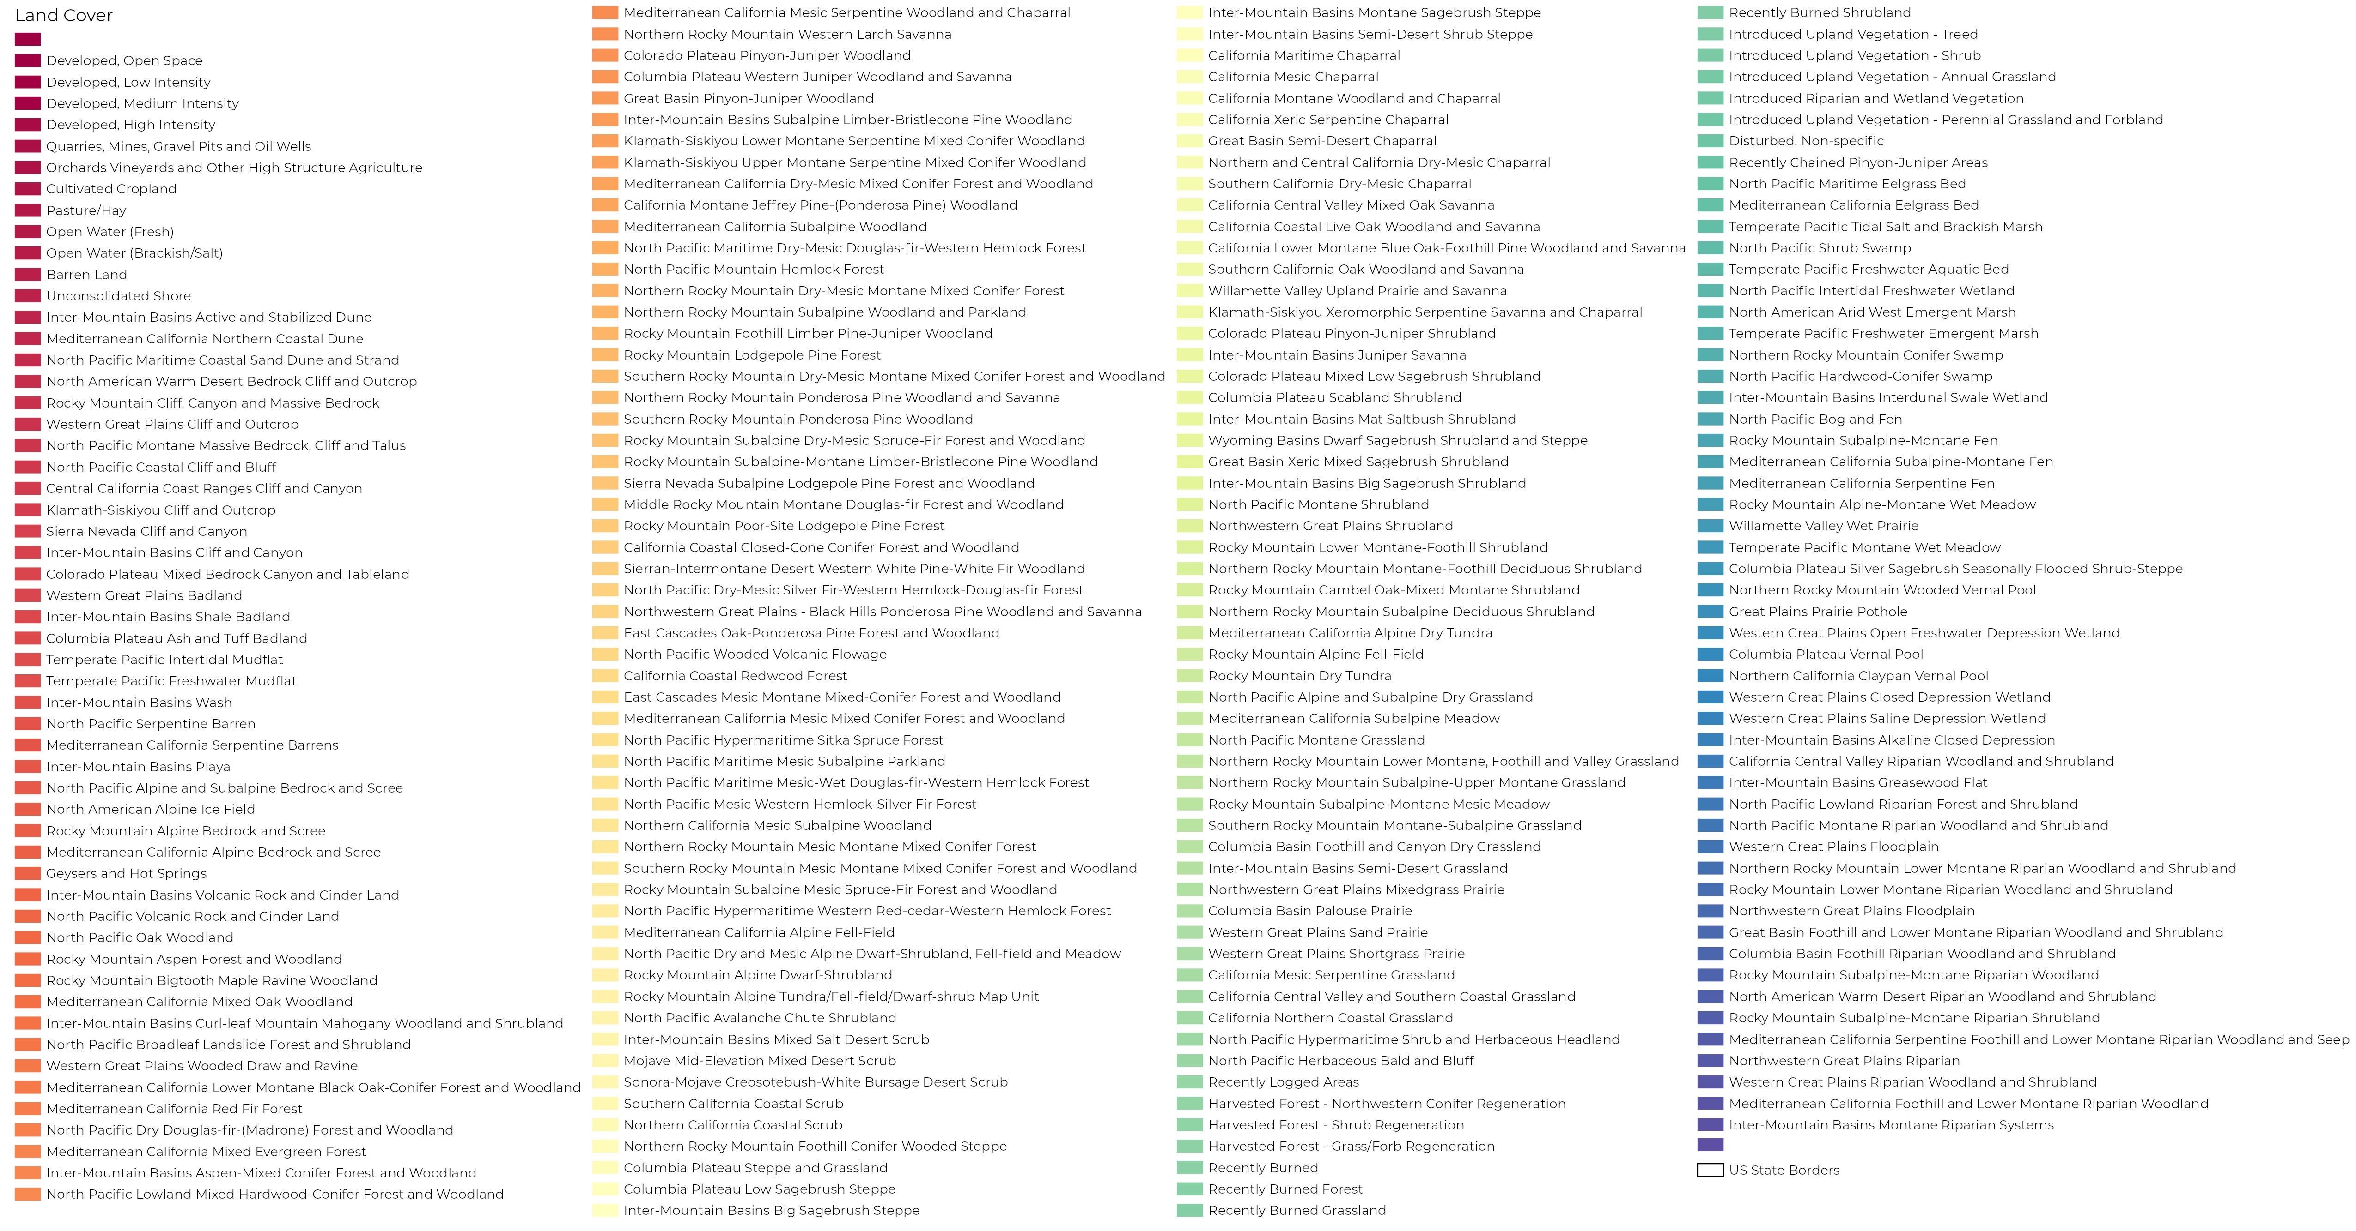
Sources – USGS GAP Land Cover
SSCI 583 | 6
Notes:
Used table to reclass values

Slide 10
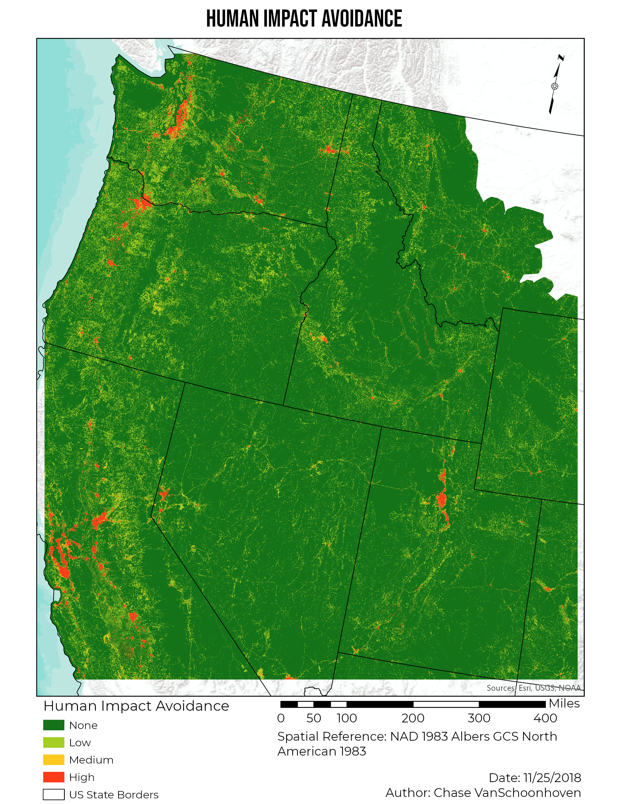
Sources – USGS GAP Human Impact Avoidance
Environments dominated by human disturbance such as roads, cities, and the constructed materials that support human habitation have profound effects on species.
High – Portions of the landscape identified as being directly influenced by human disturbance.
Medium – Portions of the landscape identified as being highly or moderately influenced by human disturbance.
Low – Portions of the landscape identified as being slightly influenced by human disturbance.
SSCI 583 | 7

Slide 11
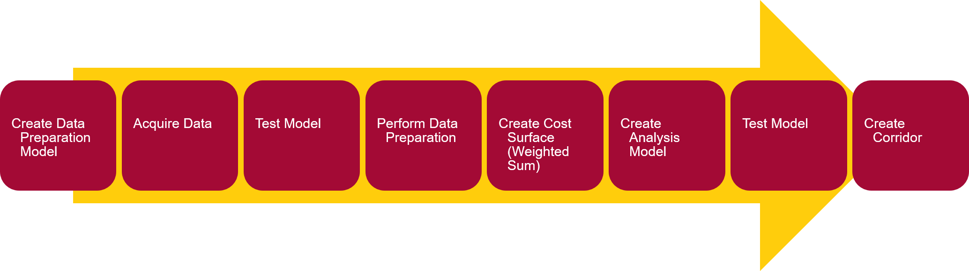
Methodology
SSCI 583 | 11
SECTION TITLE | 2
Acquire Data
Create Data Preparation Model
Test Model
Perform Data Preparation
Create Analysis Model
Create Cost Surface (Weighted Sum)
Test Model
Create Corridor

Slide 12
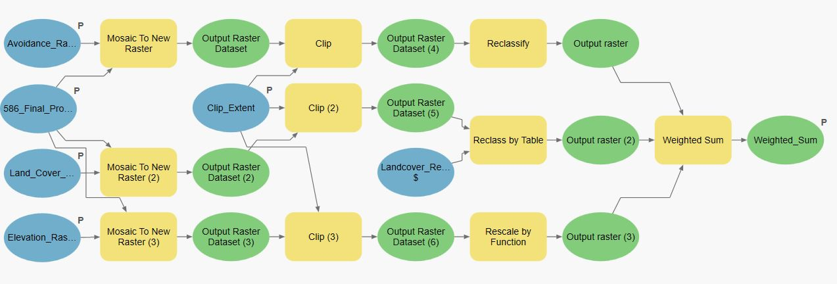

Methodology – Data Preparation Model
Mosaic to New Raster
Clip
Reclassify/Rescale
Weighted Sum
SSCI 583 | 9
SECTION TITLE | 2

Slide 13
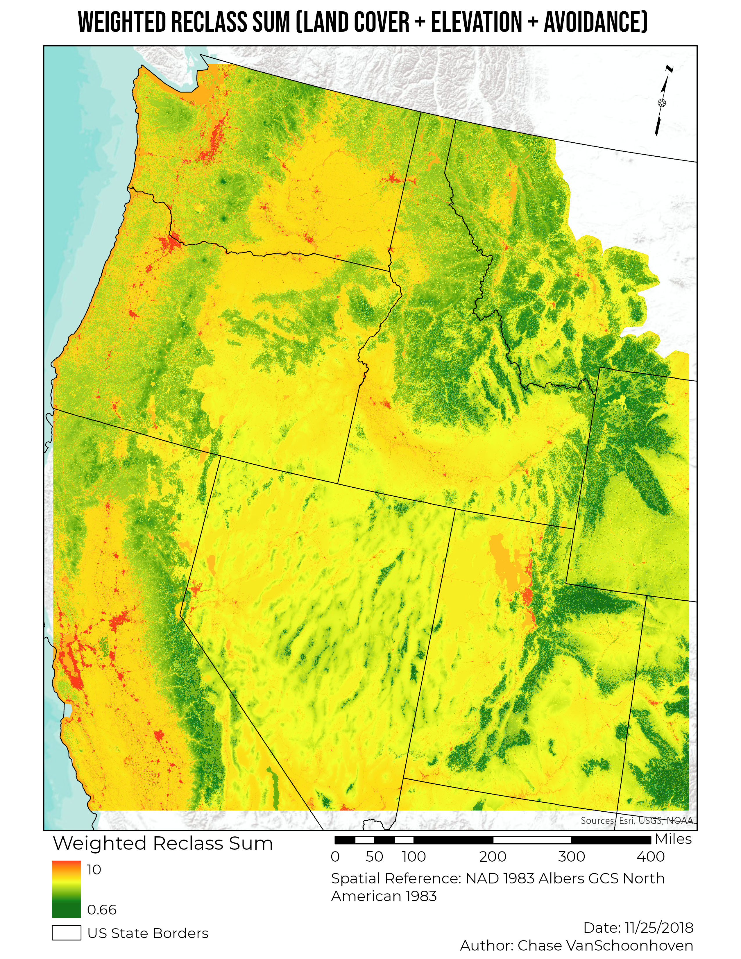
Methodology – Cost Surface
SSCI 583 | 11
SECTION TITLE | 2

Slide 14
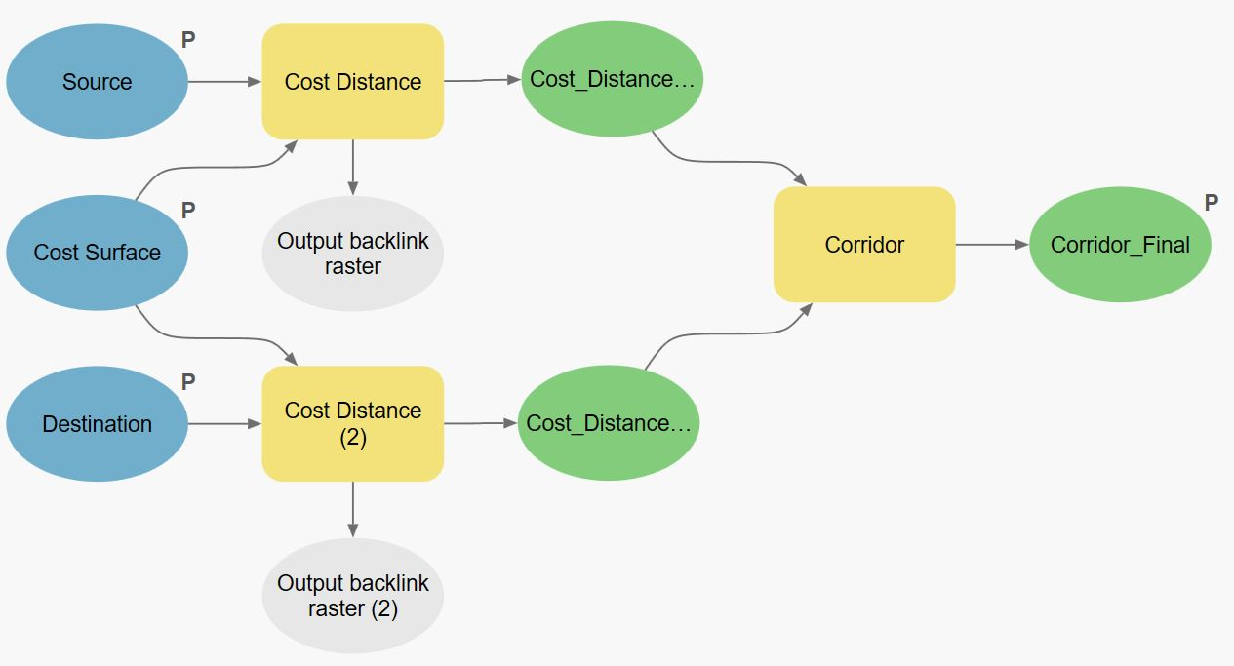
Methodology – Corridor Analysis Model
Cost Distance From Source
Cost Distance From Destination
Corridor Analysis
SSCI 583 | 10
SECTION TITLE | 2
Notes:
3 different reclasses (reclassify, reclass by function [logistical growth], reclass by table)

Slide 15
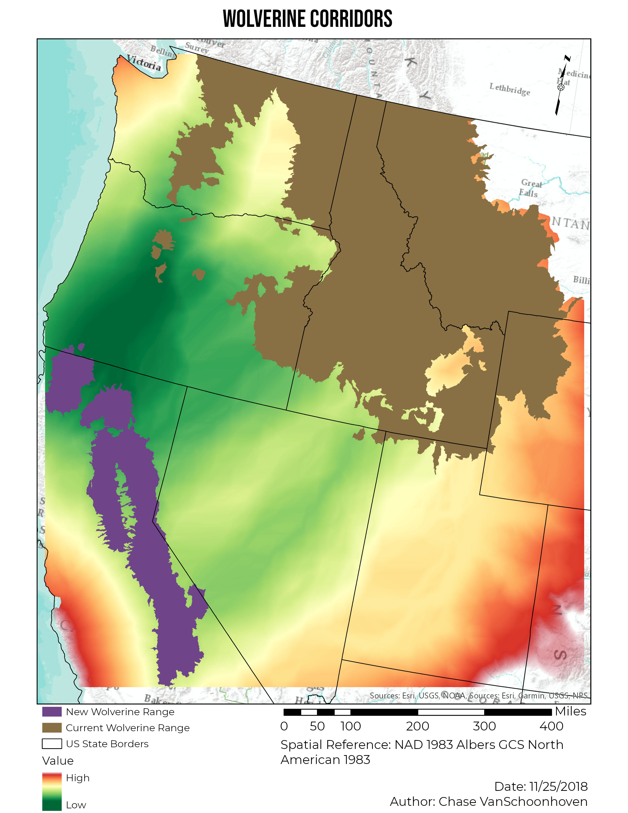
Results
SSCI 583 | 12
SECTION TITLE | 2

Slide 16
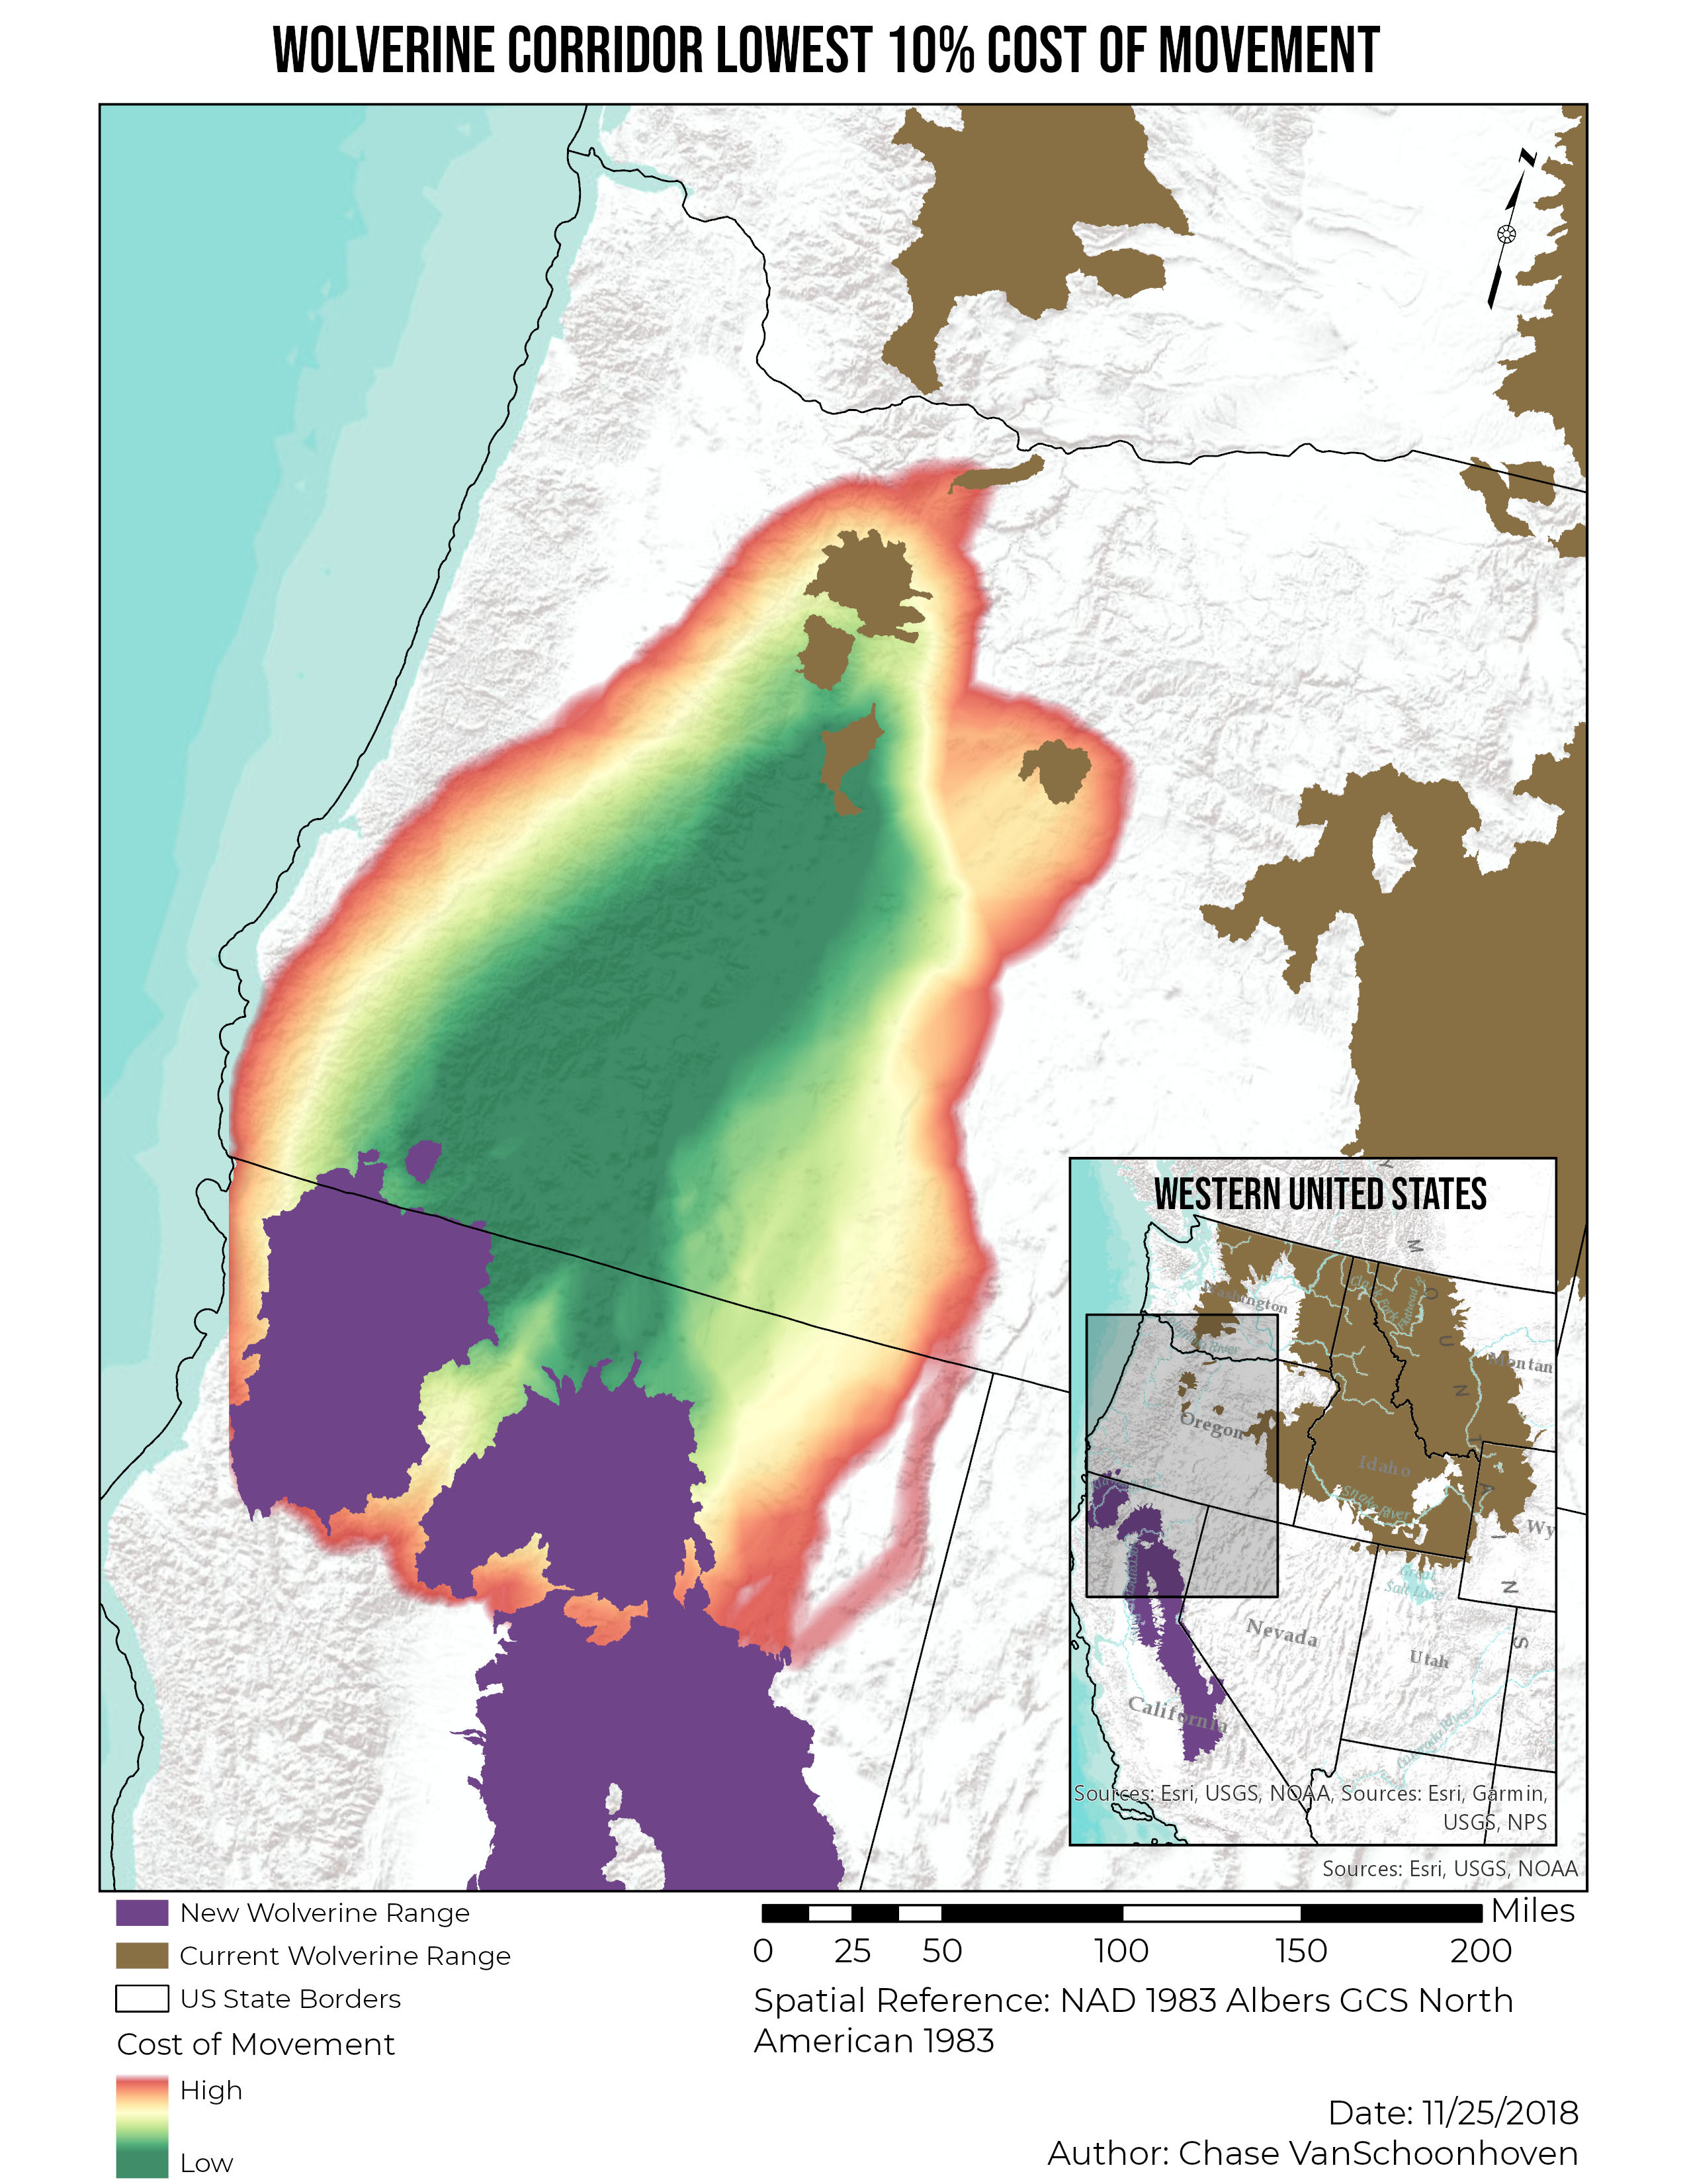
Results
SSCI 583 | 13
SECTION TITLE | 2

Slide 17
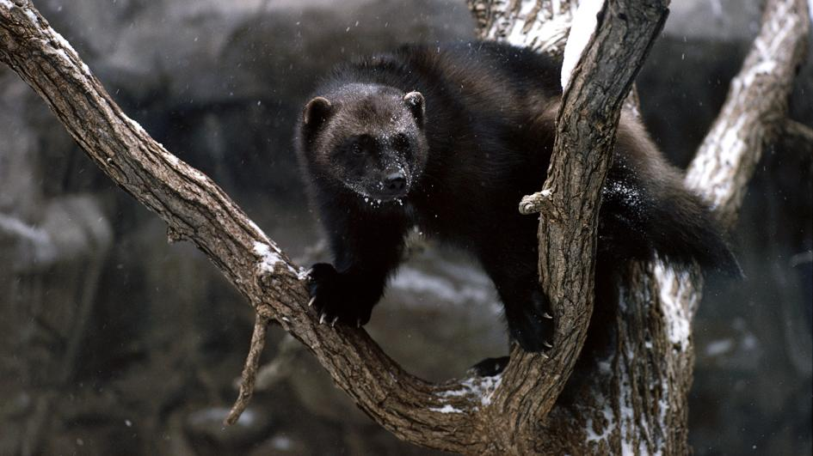
Issues / What Next?
Issues
Creation of add-in toolbar
Large file-sizes
Handling variables
What Next
Other Species
Logic Choices In Model
Exclusions
Land Ownership
SSCI 583 | 14

Slide 18
Questions?
SSCI 583

